Slide 1
Germany
Climate & Environment
By : Delisha

Slide 2
01
Germany Background
Geography, Culture/Language, Brief economic context

Slide 3
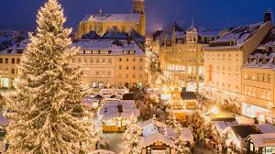
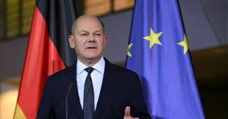
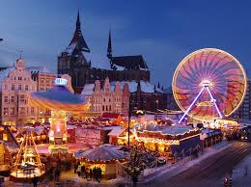
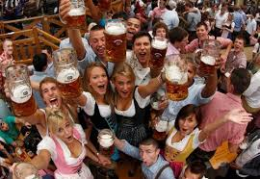
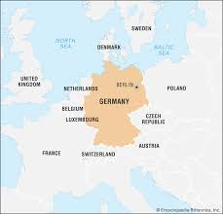
Geography
Culture/Language
Economic Context
Germany is located in Europe, specifically in the central-western region of the continent. Germany has nine neighbouring countries which are, Denmark, Poland, Czech Republic, Austria, Switzerland, France, Luxembourg, Belgium, and the Netherlands. Germany is bounded by the North Sea to the northwest and the Baltic Sea to the northeast. Germany experiences a predominantly temperate climate, characterized by warm summers, cool to cold winters, and moderate, year-round rainfall. Germany’s capital is Berlin.
Germany’s official language is standard german (Hochdeutsch) and is spoken by the vast majority of the population. It's language emphasized structure, oresision, and punctuation. Germany has a love for rich tradition, including world-renowned bread, beer, and festivals. Germany has a population of around 84 million people. The country is known for its Oktoberfest celebrations in Munich, its carnival culture, and their Christmas, also known as, Weihnachten.
The Federal Republic of Germany is made up of 16 federal states, the Lander. The Bundestag is the federal parliament of Germany. It is the only constitutional party in the country directly elected by the people of Germany. The Bundestag was established by Tite III of the Basic Law of the Federal Republic of Germany in 1949. The members of the Bundestag represent all of the German people as a whole, are not forced by any orders or instructions, and are only responsible for their conscience. The Bundestag is elected every four years by the Germans aged 18 and older.
Joachim-Friedrich Martin Josef Merz is the Chancellor of German.

Slide 4
02
The Global Issue
Defining issue, Explaining global importance, Key facts

Slide 5
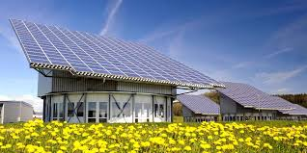
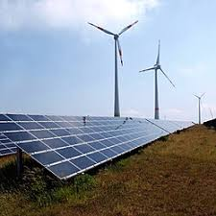

What exactly is the Issue?
Why does it matter Globally?
How does it specifically affected Germany?
Germany is facing several major crises directly tied to Russia og going war with Ukraine. The war has disrupted the major energy supplies from Russia to Germany and impacted shipping to and from German ports. Science Russie historically supplied over half of Germany's natural gas, when Russia cut ties, the industrial strain on Germany grew massive. This pressure caused higher prices and expensive production as many factories couldn’t depend on natural gas anymore.
Germany’s energy challenges matter globally because they affect energy prices, internations trades, climate change efforts, and the security of energy supplies about the world. When Germany needs to replace lost energy supplies quickly, demand and prices for oil and natural gas rise international, affecting many other countries and economies. Germany is also a major manufacturer and exporter. Higher energy costs can increase the prices for products sold around the world. Germany’s energy issue can also impact positively on other countries. Germany’s investments in renewable energy, energy efficiency, and new technologies can influence policies and innovation in other countries.
The war significantly impacted Germany because the country has depended on Russian natural gas for most of its energy. Many German families had to pay higher bills for heating and electricity, and the overall cost of living increased as many goods and services were getting affected by the energy crisis. Many businesses and factories also faced higher costs, more expensive production, and reduced profits. The economic pressure encouraged the government to prompt energy efficiency and cleaner technologies as part of the Energiewende. The Energiewende literally means “energy transition”, it's Germany strategy to transition to a low-carbon, nuclear-free, highly efficient energy economy.

Slide 6
03
Germany's Response
Germany’s actions, Evidence, International efforts

Slide 7
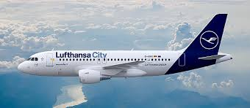

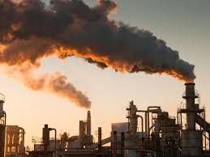
What has the Government actually done?
What has it not done?Why?
Who else is affected by this?
Even through Germany is trying really hard to only rely on green energy, it has not completely stopped using fossil fuels. Germany still needs a reliable energy source for homes, schools, hospitals, and factories. Renewable energy like solar and wind, cannot produce energy when there to no wing or sunlight. Building these also takes time and money so the country is still lacking backup. Germany has also not stopped concumming Russian LNG. Though it does not directly accept Russian LNG at its own domestic ports, it is still indirectly consuming it through its European Union neighbours and other government-owned entities
Germany’s ongoing energy crisis directly affects the rest of Europe and major energy exporting countries. Because the Europeans Union relies of a connected energy market, Germany’s crisis has forced the European Commission to disturb with emergency funding and to quickly increase it REPowerEU energy independence. The U.S and Norway became major suppliers, but Norway has essentially reached maximum capacity limits for pumping pipeline gas into Europe. Since fuel is the largest expense for airlines, the energy crisis has caused European jet fuel prices to hit all-time high. Major airlines, like the Lufthansa Group, have been forced to temporarily grounding aircraft and greatly cut seating capacity.
The German government has taken several measures to respond to the energy crisis. The government has given a relief package of 1.7 billion euros for almost all households on January 28 in 2022. Germany built new LNG (liquefied natural gas) terminals so they could import natural gas from other countries such as the United States and Qatar. Germany even requested household and businesses to reduce energy use and promoted financial support to help families and business to cope with the high energy prices. Germany also began to increase its investments in wind and solar power, and continues to work toward long-term goals to make Germany’s energy system cleaner, more secure, and more sustainable.

Slide 8
04
Consequences
Intended vs unintended, Short vs long-term, Who affected

Slide 9
What were the Intended & Unintended Consequences?
Short-term & Long-term Effects?
Intended Consequences: The nuclear phase-out was the government's primary goal to completely eliminate nuclear power to remove the risks of radioactive waste. Germany also aimed to drastically cut greenhouse gas emission by replacing fossil fuels with wind and solar power This caused renewable energy growth and the policy intended to spark massive green tech innovations and make wind and collar become the main course of electricity. Developing local power was also meant to stop Germany's reliance on buying expensive foreign oil and gas. The government wanted to create thousand of new, stable jobs in clean energy and manufacturing sectors.
Unintended Consequences: Te government decision to phase out nuclear power forces the energy gri to rely on fossil fuels during the transition =, this caused an increase in coal and lignite consumption to fill up the energy gap. Elimination cheap, reliable baseload nuclear power resulted in the average electricity prices scoring 20-30% higher than they would have been otherwise. Germany’s manufacturing sector relies strongly on energy. Higher prices reduced purchasing power and led to a slump in economic growth, and triggered fears of economic change as big industries scaled back their production.
Short Term:
Higher electricity and heating bills.
Increased costs for businesses and factories.
Government spending increased.
Long Term:
More investments in renewable energy.
Less dependence in Russian gas.
Development of new technologies and jobs.
More sustainable energy system.

Slide 10
05
Canada & Reflection
Canada comparison, Why Canadians should care

Slide 11
Canada Comparison
Both Canada and Germany are trying to reduce greenhouse gas emissions, but that are facing challenges because they have different energy resources. Germany wants to replace Russian gas and reduce emissions. Canada wants to also reduce emissions while remaining as a major oil and gas producer. In Germany, wind and solar are growing rapidly. In Canada, hydroelectric power is the major source. Germany imports LNG to replace Russian gas, while Canada exports LNG to other countries. Germany’s goal is to expand renewable energy through Energiewende. Canada’s goal is to balance economic benefits of energy exports with climate goals.
Why should Canadian Care?
Canadians should care because Germany's energy transition affects climate change, energy markets, and the economy, which also indirectly affects Canada. Both Canada and Germany are a Group of Seven (G7) countries who are trying to keep energy affordable and reliable while reducing greenhouse gas emissions. They are major economies with influence on global climate and energy policy. They face challenges of transitioning to cleaner energy while maintaining strong economies, reliable energy supplies, and affordable prices. Germany's expreserince provides lessons that Canada can learn from and built upon.

Slide 12
RESOURCES
Wikipedia Contributors. (2019, May 24). Bundestag. Wikipedia; Wikimedia Foundation. https://en.wikipedia.org/wiki/Bundestag
Clean Energy Wire. (2018, November 29). Germany’s Energiewende in brief. Clean Energy Wire. https://www.cleanenergywire.org/germanys-energiewende-brief
Gross, S., & Stelzenmüller, C. (2024, June 18). Europe’s Messy Russian Gas Divorce. Brookings. https://www.brookings.edu/articles/europes-messy-russian-gas-divorce/
Wehrmann, B. (2022, June 14). What happens if Russia’s gas supplies to Germany are cut? Clean Energy Wire. https://www.cleanenergywire.org/factsheets/what-happens-if-russias-gas-supplies-germany-are-cut

